Slide 1

⚙️ Framework Internals
SLIDE 01
What is Agent Framework Internals?
The Abstracted Architecture Powering Autonomous Systems
DEFINITION
AGENT WORKFLOW
IMPLEMENTATION
Agent Frameworks are robust software libraries that provide the orchestration layer needed to seamlessly connect LLMs with external Memory stores and actionable Tools, handling complex state management internally.
person
1. Input User - Receives raw prompt
# FRAMEWORK INIT
agent = Agent(
llm=ChatOpenAI(),
tools=[SearchTool()],
memory=BufferMemory()
)
code
2. Parse JSON - Extracts key variables
Orchestration
Abstraction
State Management
psychology
3. Route LLM Plan - Determines next action
REAL-LIFE ANALOGY
🏢
build
4. Execute Tools - Runs selected functions
# EXECUTION
response = agent.run(
"What is the current"
" stock price of Apple?"
)
Think of a corporate office. The LLM is the CEO, but the framework acts as the HR, IT, and Filing System that allows the CEO to actually run the company efficiently.
check_circle
5. Output Result - Returns answer to user
Mapping: Frameworks handle the logistics so the LLM can focus purely on reasoning.
The framework orchestrates this circular execution loop automatically, maintaining state history across interactions.
Frameworks drastically reduce boilerplate code, allowing developers to focus on agentic behavior rather than API mechanics.

Slide 2
⚙️ Framework Internals
Slide 02
The AI Application Stack
Where the framework sits in the modern GenAI ecosystem.
devices
User Interface
The front-end app interacting directly with the user.
THE FRAMEWORK LAYER (ORCHESTRATION & STATE)
The central nervous system linking interfaces, models, databases, and tools into a cohesive loop.
psychology
dns
build
LLM Provider
OpenAI, Anthropic, or local open-source models via APIs.
Vector Databases
Long-term semantic memory storage for context retrieval.
External Tools
APIs, web search engines, calculators, and custom code environments.
The framework acts as the central nervous system, connecting disparate components into a unified application.

Slide 3







Slide 03
Why Use an Agent Framework?
The primary advantages of adopting an established library.
Abstraction
Orchestration
Hides complex, repetitive API calls and JSON parsing behind simple, standardized class methods.
Automatically manages the intricate logic loops (like ReAct) required for autonomous agent behavior.
Integrations
Standardization
Provides hundreds of pre-built connectors to external APIs, databases, and document loaders.
Enforces a uniform structure for components, making team collaboration and code maintenance much easier.
Frameworks accelerate development by solving the generic plumbing problems of AI applications.

Slide 4



Slide 04
Building With vs. Without Frameworks
Without Framework
With Framework
Manual Construction: Developers must write custom logic to parse string outputs into JSON.
Standardized Components: Plug-and-play modules for memory, prompt templates, and output parsers.
Brittle Logic: Custom retry loops and error handling must be built from scratch for every new tool.
Built-in Resilience: Frameworks handle API rate limits and automatic retries natively.
High Maintenance: Hardcoded prompts become difficult to manage as the application scales.
Rapid Prototyping: Swapping out an LLM provider takes changing a single line of code.
While you can build agents from scratch, frameworks provide enterprise-grade reliability out of the box.

Slide 5
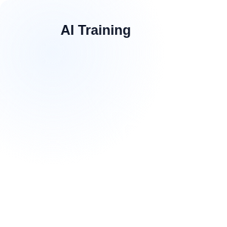








Slide 05
Popular Agent Frameworks
The leading tools shaping the Agentic ecosystem.
LangChain
LlamaIndex
CrewAI
AutoGen
The industry standard, highly modular framework for building generic LLM applications and agents.
Specialized framework focused heavily on optimal data ingestion, indexing, and advanced RAG.
Built on LangChain, designed specifically for orchestrating multi-agent, role-playing teams.
Microsoft's framework focused on conversational, multi-agent workflows and code execution.
Choose your framework based on your primary need: general workflows, data retrieval, or multi-agent teams.

Slide 6
Slide 06
Chains vs. Agents
Understanding the two fundamental operational paradigms.
Feature | Chains | Agents
Execution Path | Deterministic (Hardcoded sequence) | Autonomous (Dynamic routing)
Predictability | Extremely high | Variable (Relies on LLM reasoning)
Use Case | Data extraction, simple Q&A, formatting | Complex research, open-ended tasks
Tool Usage | Fixed (Uses specific tool at specific step) | Adaptive (Chooses tool based on context)
Always prefer a Chain over an Agent if the workflow is highly predictable and static.

Slide 7


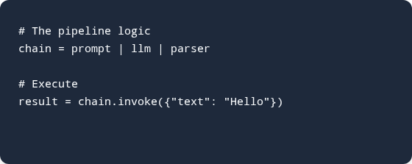
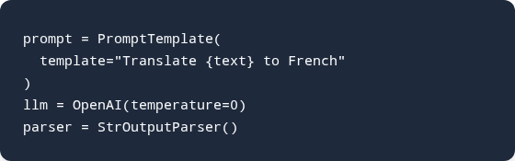
Slide 07
Conceptual Chain Logic
How frameworks pipe components together elegantly.
Modern frameworks use piping syntax to pass outputs of one component directly as inputs to the next.

Slide 8








Slide 08
Managing Tools Internally
How frameworks translate LLM intentions into executed code.
Schema Extraction
JSON Binding
Execution Engine
Error Handling
Converts Python functions into JSON schemas for the LLM.
Attaches the available tool schemas to the API request.
Runs the local code when the LLM requests a tool call.
Catches execution errors and formats them for LLM self-correction.
The Tool Registry is the bridge between the LLM's text output and the application's actual executable code.

Slide 9
Slide 09
Framework Agent Orchestration
The hidden loop managed automatically by agent executor classes.
Parse Input
Format Prompt
The framework receives the user query and injects it into the base agent prompt template.
Memory history, tool schemas, and the current goal are combined into one large context block.
Extract Tool Call
Execute & Feed Back
The framework intercepts the LLM response, parsing out the specific JSON requesting tool usage.
Runs the tool locally, appends the result as an "Observation", and loops back to Step 2.
Agent executors hide the complexity of while-loops, string parsing, and error catching from the developer.

Slide 10
Slide 10
Native vs Custom Tools
Native Tools
Custom Tools
Built-in: Provided directly by the framework (e.g., WikipediaSearch, Calculator).
User-Defined: Bespoke Python functions written by the developer for specific business logic.
Verified: Schemas and execution logic are thoroughly tested by the open-source community.
Strict Schemas: Requires explicit docstrings and type hints so the framework can extract the schema.
Instant Deployment: Can be initialized and passed to an agent with a single line of code.
Highly Specific: Connects the agent directly to internal proprietary databases or APIs.
Leverage native tools for common tasks, and build custom tools to give agents access to your unique business data.

Slide 11






Slide 11
Types of Memory Implementations
How frameworks handle state across conversation turns.
Buffer Memory
Summary Memory
Window Memory
Vector Memory
Stores the exact transcript of every message. Simple, but quickly consumes token limits.
Uses an LLM to continually condense past turns into a running summary, saving tokens.
Only retains the last 'K' interactions, strictly limiting context to recent events.
Embeds past interactions into a vector database, retrieving only semantically relevant past messages.
Frameworks allow you to swap memory types effortlessly to balance context depth with API token costs.

Slide 12
Slide 12
Tool Execution Tradeoffs
Evaluating the impact of different tool categories on agent performance.
Tool Type | Latency | Reliability | Flexibility
Web Search (Native) | Medium | Variable (Depends on web results) | Extremely High
Code Interpreter | High | Low (Prone to syntax errors) | High (Can solve novel math/logic)
Custom API Endpoint | Low | Very High (Structured data) | Low (Strictly bounded)
RAG Retrieval | Medium | High (Grounded in documents) | Medium
Mix structured custom APIs for reliability with generic search tools for flexibility.

Slide 13


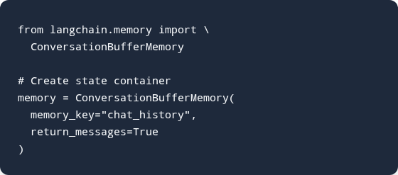
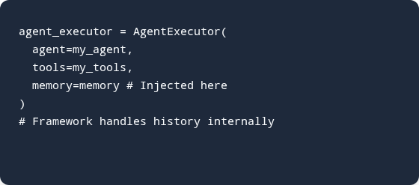
Slide 13
Memory Injection Implementation
Abstracting state management away from the core logic.
The framework automatically manages appending inputs and outputs to the memory object during execution.

Slide 14






Slide 14
Positioning of LangChain
Understanding the dominant framework in the ecosystem.
Extensive Ecosystem
Modular Design
High Abstraction
Prototyping Speed
Integrates with virtually every LLM, database, and tool provider.
Use only the parts you need (e.g., just prompts, or just memory).
Simplifies complex tasks, but can sometimes obscure underlying mechanics.
Unmatched velocity for getting an AI application from idea to working demo.
LangChain sacrifices some fine-grained control in exchange for massive development speed and connectivity.

Slide 15
Slide 15
LangChain Core Paradigms
The four pillars making up the framework's architecture.
Model I/O
Retrieval (RAG)
Standardized wrappers for communicating with various LLMs and formatting prompt inputs/outputs.
Components for loading documents, splitting text, embedding vectors, and querying databases.
Chains
Agents
Constructs that link multiple components together into a predictable, sequential pipeline.
Dynamic routing systems where the LLM determines the execution path and tool usage.
Mastering these four paradigms is essential for building robust applications within the LangChain ecosystem.

Slide 16
Slide 16
LangChain vs LlamaIndex
LangChain
LlamaIndex
Focus: Application workflows, complex chaining, and agentic action.
Focus: Deep data connection, indexing, and advanced retrieval (RAG).
Strengths: Building bots that need to do things (execute APIs, write files).
Strengths: Building bots that need to know things (querying massive internal PDFs).
Philosophy: A general-purpose Swiss Army knife for all LLM interactions.
Philosophy: A specialized pipeline optimizing the connection between LLMs and your custom data.
Use LangChain when you need an agent to take actions, and LlamaIndex when you need an agent to act as an expert researcher.

Slide 17






Slide 17
The LangChain Ecosystem
Beyond the core library: The full production suite.
LangChain
LangGraph
LangSmith
LangServe
The core open-source library for building components, chains, and simple agents.
Advanced framework for building stateful, multi-actor applications using graph-based routing.
A unified platform for debugging, testing, evaluating, and monitoring LLM applications.
A tool for instantly deploying LangChain runnables and chains as REST APIs.
The ecosystem covers the entire lifecycle: Development (Core/Graph) -> Deployment (Serve) -> Observability (Smith).

Slide 18
Slide 18
LangChain vs CrewAI
Choosing the right abstraction level for agents.
Feature | LangChain (Agents) | CrewAI
Architecture | Highly customizable, granular control | Opinionated, built on top of LangChain
Agent Focus | Single, complex generic agent | Teams of role-playing specialized agents
Setup Speed | Requires wiring components together | Extremely fast for team topologies
Best For... | Custom tools, unique routing logic | Collaborative workflows, delegating tasks
CrewAI provides a higher-level abstraction specifically designed to make multi-agent orchestration simple.

Slide 19


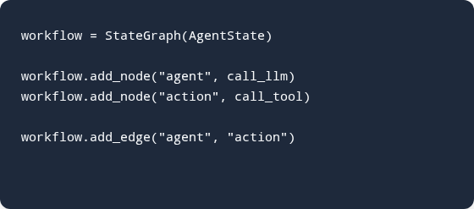
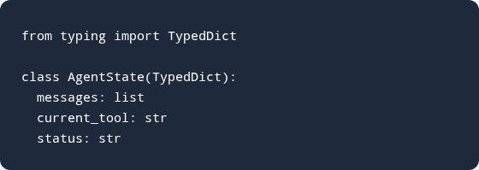
Slide 19
LangGraph State Management
Conceptualizing graph-based stateful orchestration.
LangGraph models agents as state machines, making complex loops and branching highly predictable.

Slide 20





Slide 20
Design Considerations: Reliability
Ensuring autonomous systems don't fail silently.
Type Enforcement
Fallback Models
Retry Parsers
Max Iterations
Validating JSON tool outputs strictly using Pydantic.
Routing to a smaller model if the primary API experiences downtime.
Asking the LLM to fix its own formatting errors automatically.
Capping the reasoning loop to prevent infinite token consumption.
Frameworks provide the tools for reliability, but developers must explicitly configure these safety nets.

Slide 21
Slide 21
Managing Non-Determinism
Taming the unpredictable nature of LLM reasoning.
Temperature Control
Strict Schemas
Set LLM temperature to 0 for strict tool calling, reducing creative hallucinations.
Define tool parameters exactly, providing enums and explicit formatting instructions.
Evaluation Loops
Grounding Data
Implement a "Critic" node that verifies the output before returning it to the user.
Force the agent to cite internal RAG documents to justify its final answer.
Non-determinism is a feature for creative writing, but a bug for enterprise agents executing workflows.

Slide 22
Slide 22
Scalability vs Latency
Agentic Workflows
Directed Chains
Performance: High accuracy through multi-step reasoning and self-correction.
Performance: Lower accuracy on complex tasks, rigid boundary conditions.
Latency: Very slow (often 10-30 seconds) due to multiple sequential API calls.
Latency: Very fast (1-3 seconds), executing exactly the required steps.
Cost: High token consumption from passing memory and tool schemas repeatedly.
Cost: Highly efficient, utilizing minimal context windows.
Do not default to Agents. Start with a Chain for speed, and upgrade to an Agent only if dynamic routing is strictly required.

Slide 23




Slide 23
Security Guardrails
Protecting systems against autonomous execution risks.
Tool Scoping
Prompt Injection
PII Masking
Read-Only
Agents must operate with the principle of least privilege, unable to access broad admin APIs.
Sanitizing user input so malicious requests cannot override the agent's core system prompt.
Using framework middleware to scrub personal data before it is sent to external LLM providers.
Ensuring database tools are strictly scoped to SELECT queries to prevent catastrophic data loss.
Security must be designed into the framework architecture, not bolted onto the LLM prompt.

Slide 24
Slide 24
Agent Evaluation Metrics
Measuring the success of non-deterministic systems.
Metric | Description | Importance Focus
Tool Accuracy | Did the agent select the correct tool and parameters? | Core Reliability
Goal Completion | Did the final output answer the user's intent? | User Experience
Latency (TTFT) | Time To First Token; how long before the user sees progress. | Engagement
Token Efficiency | How many tokens were burned in the reasoning loop? | Operational Cost
Unlike traditional software tested via unit tests, agents require probabilistic evaluation pipelines.

Slide 25


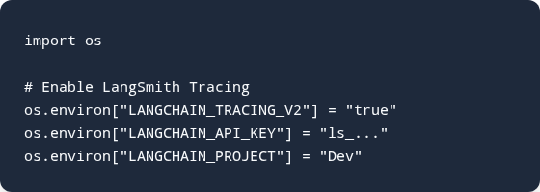
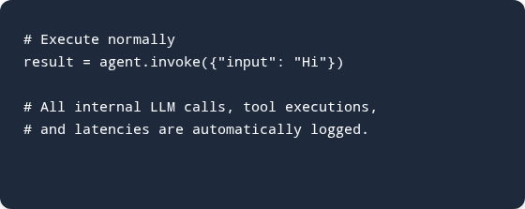
Slide 25
Telemetry Configuration
Implementing tracing to debug complex loops.
Observability is non-negotiable. Without tracing, debugging a failing agent loop is nearly impossible.

Slide 26



Slide 26
Human-in-the-Loop Implementation
Designing frameworks for safe escalation.
Breakpoints
State Persistence
Human Review
Resumption
Framework halts execution just before a high-risk tool call.
Agent's current memory and plan are serialized and saved.
User reviews the intended action and modifies parameters if needed.
Execution continues using the human-approved state.
Stateful frameworks like LangGraph are required to pause, persist, and resume agent processes reliably.

Slide 27
Slide 27
Advanced Routing Mechanisms
How frameworks navigate complex multi-path logic.
Semantic Router
Fallback Router
Embeds user queries and routes them to specific chains based on vector similarity (fastest).
Attempts execution with primary logic; automatically routes to a secondary chain upon failure.
Tool Router
Multi-Agent Router
Standard agent behavior where the LLM evaluates the prompt and selects the optimal tool path.
A "Supervisor" LLM evaluates the task and delegates it to the most qualified subordinate agent.
Intelligent routing minimizes latency by bypassing complex agents for simple, predictable requests.

Slide 28
Slide 28
Monolithic vs Micro-Agents
Micro-Agents
Monolithic Agents
Design: Distinct agents with narrow prompts and only 1-2 specialized tools each.
Design: One giant system prompt giving a single LLM access to all 15 tools.
Benefit: Highly focused, resilient, and easier to debug specific failure points.
Issue: Context degradation. The LLM gets confused about which tool to use, leading to high error rates.
Requirement: Needs a strong framework orchestrator to handle handoffs.
Maintenance: Extremely fragile to prompt updates.
As system complexity grows, break monolithic agents down into orchestrator-managed micro-agent teams.

Slide 29




Slide 29
Multi-Agent Topologies
Structuring collaboration between specialized models.
Hierarchical
Sequential
Broadcast
Voting
A Supervisor agent breaks down tasks and delegates to Worker agents, compiling the final result.
Output of Agent A is passed directly as input to Agent B (e.g., Writer -> Editor -> Publisher).
A task is sent to all agents simultaneously; the fastest or most confident response wins.
Multiple agents solve the same problem; a meta-agent evaluates and selects the best consensus.
Frameworks like CrewAI are designed specifically to implement these complex topologies with minimal code.

Slide 30
Slide 30
Choosing a Framework
Aligning your project requirements with the right tool.
Project Scenario | Recommended Framework | Primary Reason
Rapid Prototyping | LangChain | Massive community, easy syntax, vast integrations.
Document-Heavy (RAG) | LlamaIndex | Unmatched data parsing, indexing, and retrieval algorithms.
Multi-Agent Collaboration | CrewAI | Abstracts role-playing team dynamics beautifully.
Stateful, Loop-Heavy Apps | LangGraph | Provides low-level control over state transitions and cycles.
There is no single "best" framework; architectural choice depends entirely on your specific workflow.

Slide 31


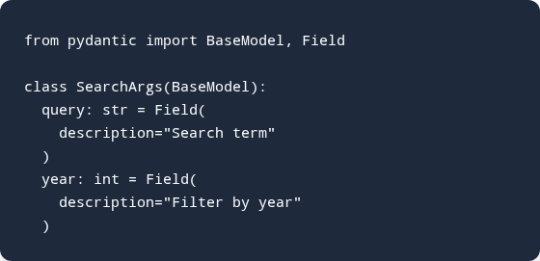
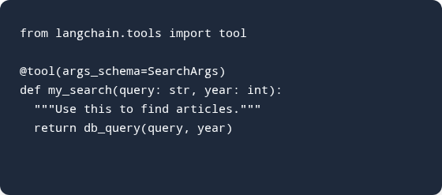
Slide 31
Custom Tool Schema
Enforcing robust inputs via frameworks.
Strict Pydantic schemas guarantee the agent knows exactly what data types are required, preventing execution errors.

Slide 32





Slide 32
Common Framework Pitfalls
Navigating the risks of high-abstraction libraries.
Over-Abstraction
Version Churn
Token Bloat
Debugging
Hiding too much logic makes it difficult to fix deep underlying errors.
Rapid framework updates can frequently break existing production code.
Default memory wrappers can silently consume massive context windows.
Without telemetry, tracing a failed tool call through abstraction layers is tough.
Understand what the framework does under the hood so you can troubleshoot effectively when the abstraction leaks.

Slide 33
Slide 33
Best Practices for Framework Adoption
Strategies for scaling agentic systems reliably.
Start with Chains
Limit Tool Options
Do not build an Agent unless dynamic routing is strictly required. Chains are faster and cheaper.
Giving an agent too many tools degrades decision-making. Keep toolsets focused and narrow.
Monitor Costs Closely
Version Control Prompts
Agent reasoning loops can burn through tokens. Set max iteration limits immediately.
Treat system prompts as production code. Small prompt tweaks can break entire framework pipelines.
Simplicity is the ultimate sophistication in Agent design. Rely on the framework, but keep the architecture lean.

Slide 34
Slide 34
Open Source vs Managed Frameworks
Open Source (LangChain)
Managed (AWS Bedrock Agents)
Customization: Infinite. You own the code and the orchestration logic.
Security: Enterprise-grade compliance, VPC integration, and built-in IAM roles.
Deployment: Requires self-hosting, managing infrastructure, and scaling compute manually.
Ease of Use: Click-and-drag orchestration; framework logic is handled by the cloud provider.
Cost: Free to use, but high engineering overhead to maintain in production.
Lock-in: High dependency on the specific vendor's ecosystem and pricing model.
Open-source frameworks provide flexibility, while managed cloud agents prioritize enterprise security and compliance.

Slide 35





Slide 35
The Future of Agent Frameworks
Where the architecture is heading next.
Standardized Protocols
Edge Execution
Memory Persistence
Autonomous Discovery
Agents from different frameworks (e.g., LangChain communicating natively with AutoGen).
Frameworks optimized for running small, specialized agents locally on mobile devices.
Built-in semantic memory that travels with the user across different agentic applications.
Agents writing and compiling their own tool schemas on the fly to interact with undocumented APIs.
Frameworks will evolve from simple orchestrators into foundational operating systems for autonomous AI.

